Slide 1
Exercises

Slide 2
Basic Find() commands
From the sample_mflix database, list the most recently released “Romance” movie in the catalog.
Just list the title and release date
From the sample_mflix database , how many “Romance” movies starred Nicole Kidman?

Slide 3
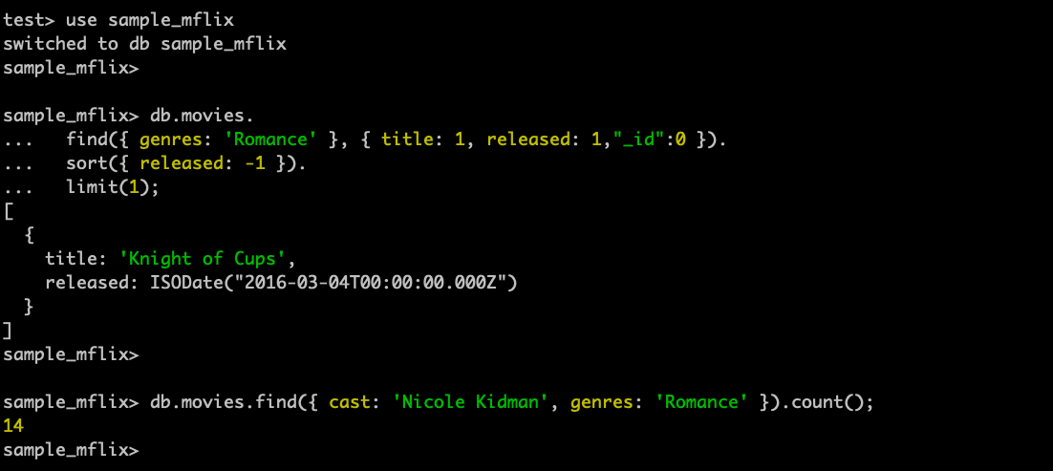
Answers

